Slide 1
GIT & GITHUB

Slide 2
Contents
Version Control System
Types of Version Control Systems
Distributed Version Control System
Git Basics
Steps to get your project into Git
Three States
Recording changes to the repository
Checking the status of your Files
Viewing Staged and Unstages changes
Committing your Changes
Removing Files
Moving Files
Viewing the commit History
Changing your last commit
Unstaging and Unmodifying
Working with remotes
Branching
Merging
Rebasing

Slide 3
Version Control System
Version Control System (VCS) is a software that helps software developers to work together and maintain a complete history of their work.
Some of the feature of VCS as follows:
Allow developers to work simultaneously
Does not allow overwriting on each other changes.
Maintain the history of every version.
Version control is a system that records changes to a file or set of files.
The following are the types of version control systems:
Local Version Control System (Ex) RCS
Centralized Version Control System (Ex) CVS, Subversion, Perforce
Distributed Version Control System (Ex) Git , Mercurial, Bazaar or Darcs

Slide 4
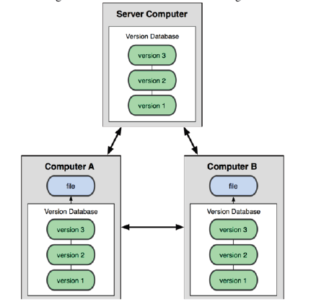
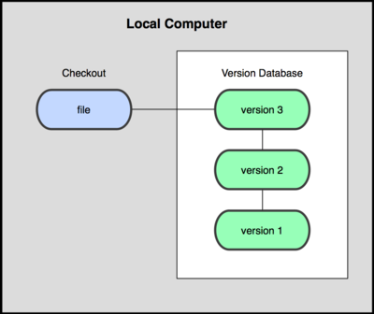
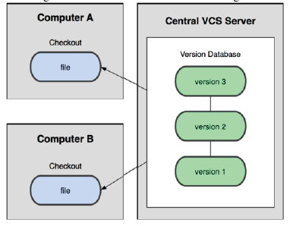
Types of version control systems
Distributed VCS
Local VCS
Centralized VCS

Slide 5
Distributed Version Control System
In Distributed VCS, every contributor has a local copy or “clone” of the main repository i.e. everyone maintains a local repository of their own which contains all the files and metadata present in the main repository.
They can update their local repositories with new data from the central server by an operation called “pull” and affect changes to the main repository by an operation called “push” from their local repository.
Distributed version control system(DVCS) keeps track of software revisions and allows many developers to work on a given project without maintaining a connection to a common network.
(Ex) Git, Mercurial, Mercurial, Bazaar

Slide 6

Git Basics
GIT means Global Information tracker. It is free and open source tool
Git is a SCM(Source Code Management), where it stores all files in repository(local/server)
Git is a version control system for tracking changes in computer files and created in 2005 by Linus Torvalds creator of Linux kernel. Now it is maintained by Junio Hamano.
Git is a Distributed Version Control System that work on a single project without having to be in a same network. It is not dependent on network access or a central server.
Git Co-ordinates work between multiples of developers and tracks every single version, changes and history that made on the system files/projects.
Git can be revert back to any specific version of any file at any time as long as it is stored in repository.
Using Git you will have Repository in local machine, where you will do changes and commit, the push that file to Remote Repository like Git Hub or Bit Bucket.

Slide 7
Steps to get your project into Git
There are two steps to get the project into the git.
Step 1 : Cloning the existing Git repository from the server to your
local git repository.
Commands:
git clone git://github.com/schacon/grit.git(URL)
Step 2 : Import the existing project or directory into your local
git repository and push into the remote git repository.
Commands:
git init // Create an empty Git repository or reinitialize an existing
one
git add . // Add file contents to the index
git commit -m ‘ initial version’ // Record changes to the local
repository
git push origin master // Push the code into remote repository

Slide 8
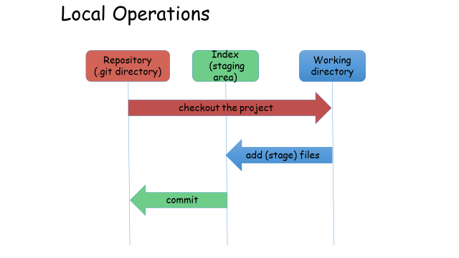
Three states
The workflow of Git.
Step 1 − You modify a file from the working directory.
Step 2 − You add these files to the staging area.
Step 3 − You perform commit operation that moves the files from the staging area. After push operation, it stores the changes permanently to the Git repository.

Slide 9
Checking the status of Your files
Command : git status
1.Untracked Files - Files in your working directory that are not present in your last snapshot and staging area.
2. Tracked Files - Files that are present in the last snapshot
The following command is used to make the file status as trackable
Command : git add filename
3. Staging Modified Files – A File which is already tracked and has
been modified in the working directory, but not yet staged.
4. Unstaging Modified Files - A File that is out of the staging area.
The following command is used to make the file unstaged
Command : git reset HEAD filename

Slide 10
Viewing Your Staged and Unstaged Changes
To view the difference between staged and unstaged files
Command : git diff
To view the difference between staged and the last committed file
Command : git diff –cached
Note : git diff does not show the difference of staged and the last committed file

Slide 11
Committing Your Changes
The simplest way to commit is to type
Command : git commit
To commit along with comments
Command : git commit –m “Comments”
Skipping the Staging Area:
To skip the staging area during commits
Command: git commit –a –m “Comments”

Slide 12
Removing Files & Moving Files
To remove the file
Command : git rm filename
To remove the file from staged area
Command : git rm -- cached filename
The metadata stored in Git does not tell you whether the file is renamed.
To rename a file in Git:
Command : git mv file_from file_to

Slide 13
Viewing the commit history
To view the commit history
Command : git log
To view the difference introduced in each commit
Command : git log p
To limit the output for last two entries
Command : git log p -2€
To view the history in oneline
Command : gitlog --oneline

Slide 14
Changing Your Last Commit
To change the last commit (if we forgot to add any file)
Command : git commit –amend
This will take the file to the staging area and use it for commit
Example:
git commit –m ‘comments’ // Record changes to the repository
git add filename // Realize, you forgot to add the file
git commit –amend // Record changes to the repository with newly
added file

Slide 15
Unstaging and Unmodifying
To make the Staged file to a Unstaged file
Command : git reset HEAD filename
To make the Modified file to an unmodified file
Command : git checkout filename

Slide 16
Working with remotes
To push our code to the remote server (actual git repository)
Command : git push origin branch name
To pull the code from the remote server (actual git repository)
Command : git pull
To get the newly created branches in our local repository
Command : git fetch

Slide 17
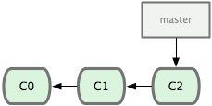
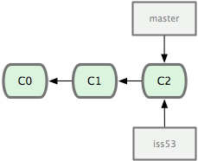
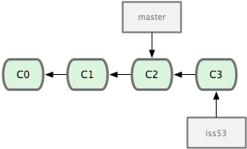
Branching
To create a branch in local repository
Command : git checkout –b branchname
To delete a branch in local repository
Command : git branch –d branchname

Slide 18
Merging the branch
Merging brings two lines of development together while preserving
the ancestry of each commit history.
Command : git merge branchname
git checkout devel // Switch to devel branch in local repository
git pull // Pull the latest code of devel from remote repository
git merge hotfix // Merge the hotfix branch into devel branch present
in the local repository
git push origin devel // Merged devel branch is pushed to the remote repository

Slide 19
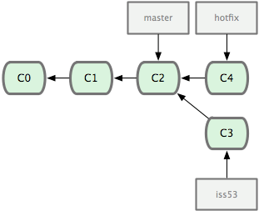
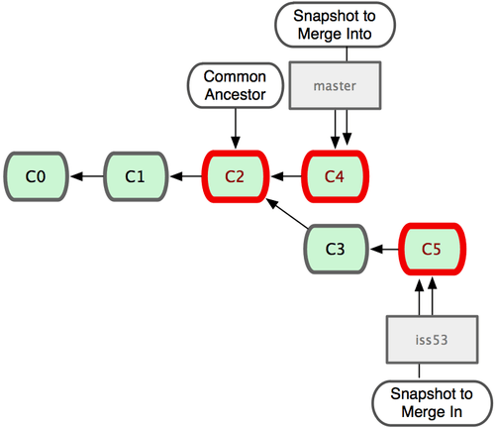
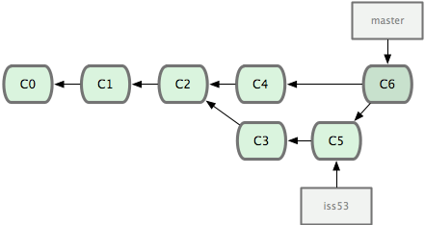
Example for Merging the branch

Slide 20
Rebasing the branch
Rebasing unifies the lines of development by rewriting changes from
the source branch so that they appear as children of the destination
branch
Command : git rebase branchname
git checkout devel // Switch to devel branch in local repository
git pull // Pull the latest code of devel from remote repository
git rebase hotfix // Get the hotfix branch changes to the devel branch
present in the local repository
git push origin devel // Rebased devel branch is pushed to the remote
repository

Slide 21
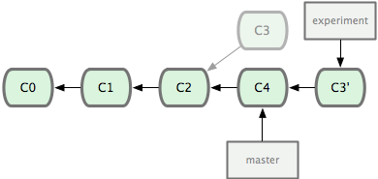
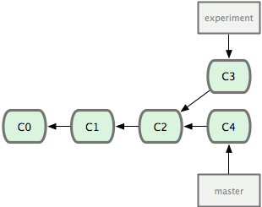
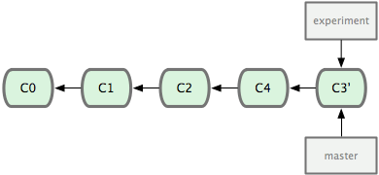
Example for Rebasing a branch

Slide 22
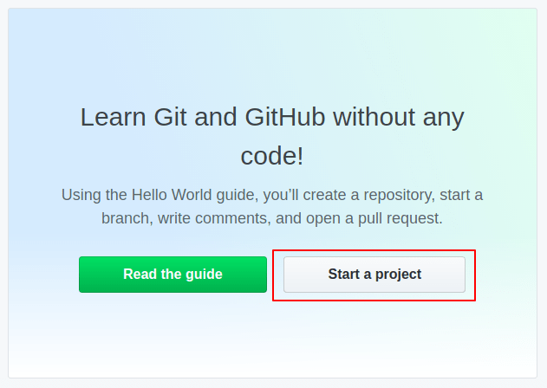
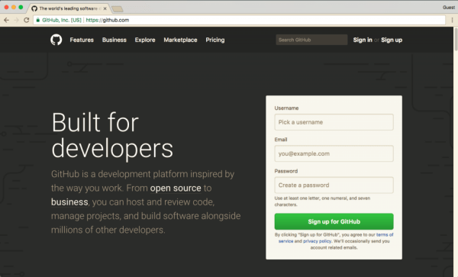
Create GitHub Repository
https://github.com/github

Slide 23
Basic Commands of Git
Commands: −
$git init -> Create an empty Git repository
$git config –global user.name “name”->
$git config –global user.email “email”->
$git add “file name”-> add file to your staging area.
$git commit –m ”1st message”-> Commit a stage file.
$git status -> to see the state of your files(add, modified, remote).
$git log->to get history of your commits or commits made by someone else.
$git remote add origin”link”->Add the URL link from GitHub.
$git push origin master->pushes the file from local repo to Git hub(server).
$git pull origin master->pulls the files from Git hub to local area repo.
$git push –f -u origin master-> pushes the updated & force file from local repo to Git hub server.

Slide 24

Role Of Git In Projects
Plan
Code
Shared Repository
Continuous Integration
Monitor
Build
Configuration Management
Deploy
Test
Tools like Git enable communication between the development and the operations team. When you are developing a large project with a huge number of collaborators, it is very important to have communication between the collaborators while making changes in the project. Commit messages in Git play a very important role in communicating among the team. The bits and pieces that we all deploy lies in the Version Control system like Git. To succeed in DevOps, you need to have all of the communication in Version Control. Hence, Git plays a vital role in succeeding at DevOps.

